Slide 1

Exam AZ-801: Configuring Windows Server Hybrid Advanced Services Crash Course
Tim Warner
@TechTrainerTim

Slide 2


Tim Warner
Based in Nashville, TN, US
Central time zone
MCT, MVP
Twitter: @TechTrainerTim
Badge: TechTrainerTim.com

Slide 3
Day 1 of 2 Agenda
Introduction
Windows Server hybrid security
Windows Server high availability
Disaster Recovery (start)

Slide 4
Day 2 of 2 Agenda
Content catch-up
Disaster Recovery (finish)
Server and Workload Migration
Monitoring and Troubleshooting

Slide 5
Course Materials
timw.info/az801

Slide 6
Course Expectations
We'll learn by doing – at least 70 percent demo
Real-world approach
Please review the recordings…several times!
10-minute break at midpoint
I’m here to answer your questions – take advantage of this
Use the Q&A panel

Slide 7

Session Recordings

Slide 8

Session Recordings

Slide 9

Session Recordings

Slide 10


Mobile Browser: learning.oreilly.com

Slide 11



O'Reilly Mobile App

Slide 12
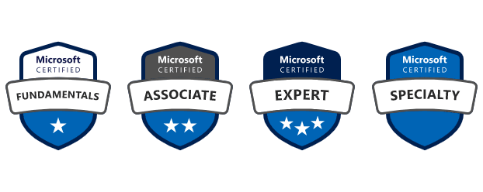
Microsoft Certification Tiers

Slide 13
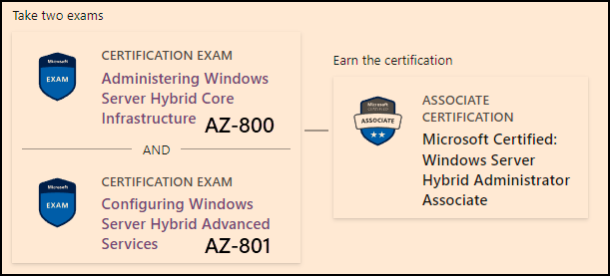
Windows Server Hybrid Admin Assoc.
1-year cert validity

Slide 14

Tim's Certification Study Model

Slide 15
Thank you!
Course materials: timw.info/az801
Twitter: @TechTrainerTim
Work: timw.info/ps
Web: TechTrainerTim.com

Slide 16
Security

Slide 17
Title

Slide 18
High Availability

Slide 19
Title

Slide 20
Disaster Recovery

Slide 21
Title

Slide 22
Migration

Slide 23
Title

Slide 24
Monitoring

Slide 25
Title

Slide 26
Exam Prep

Slide 27


Single-Answer Multiple Choice

Slide 28

Multiple Answer Multiple Choice

Slide 29
Repeated Scenario
You need to move an Azure VM to another hardware host.
Solution: You redeploy the VM.
Does this solution meet the goal?
Yes
No

Slide 30
Repeated Scenario
You need to move an Azure VM to another hardware host.
Solution: You create a proximity placement group.
Does this solution meet the goal?
Yes
No

Slide 31

Select and Place

Slide 32

Build List and Reorder

Slide 33
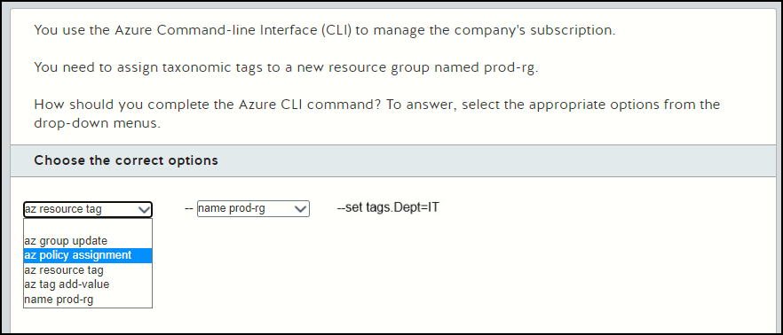
Active Screen

Slide 34

Case Study

Slide 35






Performance-Based Lab

